Slide 1


2025 Selection Cycle
Opportunity for a Lifetime

Slide 2

Who are
Marshall Scholars?

Slide 3
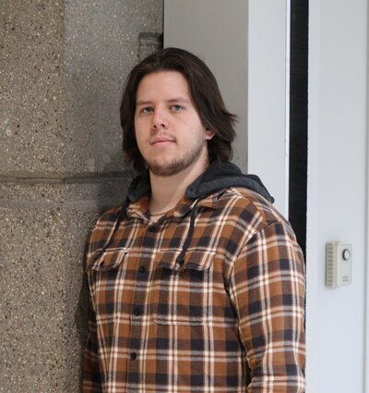


Advocates
Soldiers
Innovators

Slide 4



Musicians
Authors
Community
Leaders

Slide 5
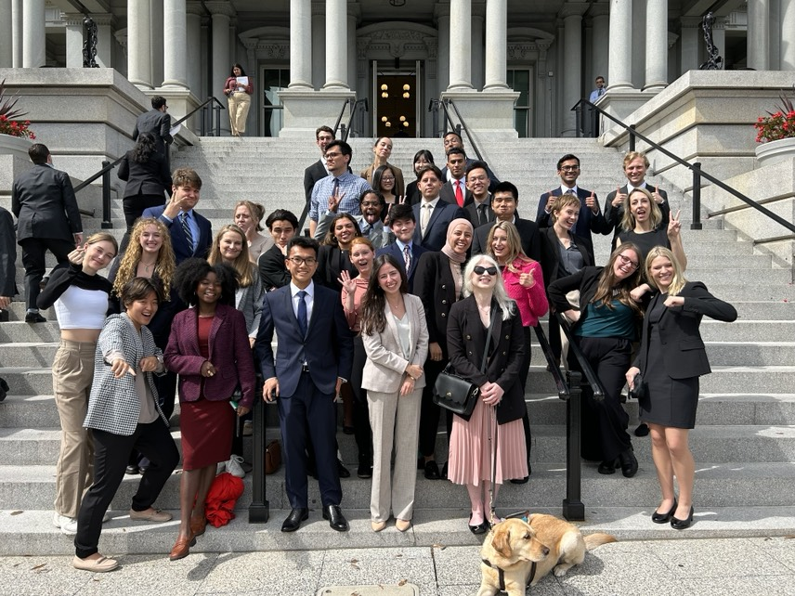
A Diverse Community

Slide 6


A Brief History
Established in 1953
The UK Parliament created the programme as a thank you for US economic aid post-WWII, under the ”Marshall Plan”
Goal: ”To enable intellectually distinguished young Americans, who will become their country’s future leaders and decision makers, to study in the UK.”
General George C. Marshall

Slide 7

Eligibility
  You must have graduated from your undergraduate institution after April 2022
  You must hold your first undergraduate degree from an accredited 4-year institution by September 2025.
  You must be a US Citizen;
  You must hold an undergraduate GPA of 3.7 or higher at time of application and graduation.
  You must not have studied or hold a degree equivalent qualification from a UK university, GSCE or A-levels taken at a school in the UK (study abroad OK)

Slide 8
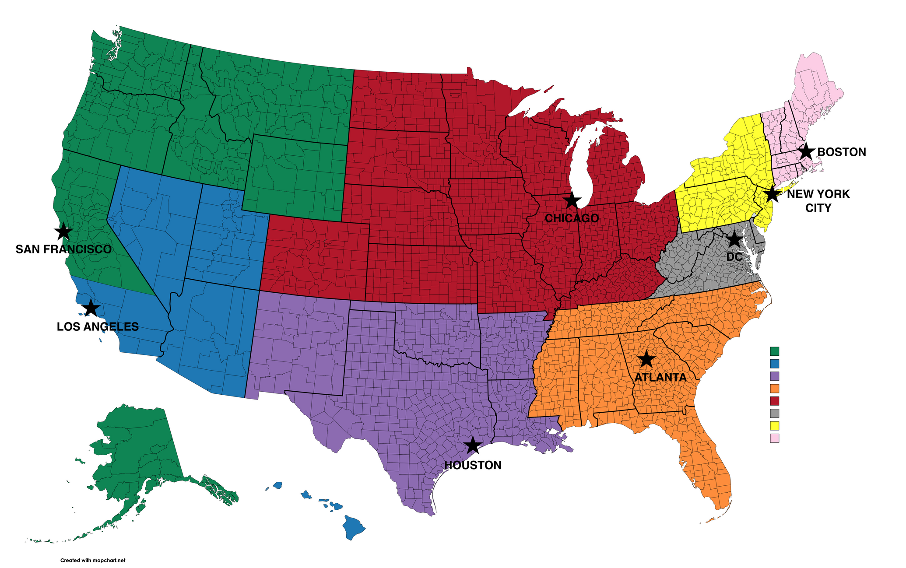
Application Regions
You can apply in region of…
  Permanent home address
  Undergraduate institution
Students can apply through one of the following consulates:
  Atlanta
  Boston
  Chicago
  Houston
  Los Angeles
  New York
  San Francisco
  Washington, DC (Embassy)

Slide 9


Application Components
Basic Form & Short Answer
Essays
Transcripts
University’s Endorsement
3 Letters of Recommendation

Slide 10

Academic Merit
Evidence of strong & relevant academic background
Knowledge of proposed courses and supervisors
Quality of programs of study
Quality & breadth of recommendations
Notes:
10

Slide 11


Leadership Potential
Ability to deliver results
Strength of Purpose
Creativity
Self-Awareness

Slide 12

Ambassadorial Potential
Knowledge of US-UK relations
Evidence of
Transferable extra-curriculars
Interpersonal skills &
Ability to engage others
Confidence & ability to
seize opportunities

Slide 13
Route Map
One-Year Scholarship
  12 month Master’s
  Research or Taught
  No extension
Two-Year Scholarship
  Two 1-year Master’s at same or different university OR
  One 2-year Master’s OR
  At least 2 years of PhD
Two-Year Scholarship w/ possible 3ʳᵈ year extension
  Complete 1 year Master’s; Start PhD in Year 2
  Upgrade from 2-year research Master’s*
  Continue 2 previous years of PhD*
*Third year funding is possible, but not guaranteed; students must apply during their 2ⁿᵈ year. See website for more details.

Slide 14

Scholarship Timeline
Early Dec
Winners announced
Mid-Late Oct
Shortlist Meetings
Late Sept
Application deadline
Week of 18th Nov
Interviews

Slide 15

Interviews
  30 minutes long at consulate in region of application
  Travel costs are covered by the Marshall Commission (no international flights)
  Most committee members are American and most are Marshall Scholars (though not a requirement)
  All thematic areas of expertise covered by selection committee

Slide 16
2024 Class at a Glance
Type of University | Endorsed | Interviewed | Selected
Private (Research & Liberal Arts) | 44.43% | 42.5% | 43.14%
State/Public | 34.99% | 21.88% | 19.61%
Ivy League | 15.11% | 25.63% | 29.41%
Service Academies | 4.37% | 8.75% | 7.84%

Slide 17
2024 Class at a Glance
Preferred UK Destination | Selected
Oxford & Cambridge | 52.94%
London Universities | 21.57%
Other Universities in England | 15.69%
Unis in Scotland, Wales and Northern Ireland | 9.8%
Tip: Your preferred UK university should be based on the type and strength of the degree programme you’re seeking

Slide 18
5 Tips for Choosing a UK University
  Do your research
  Why you choose to apply for a university matters greatly to selection committees. Conduct thorough research on programmes in your academic field to choose a school you believe will best support your academic and professional goals.
  2. Talk to UK professors
  UK universities are home to some of the world’s leading researchers and professors. Consider reaching out to professors for information, advice or to seek assistance in developing a research plan.
  3. Consider universities outside London/Oxbridge
  The best programme for your interests might not always be found in London, Cambridge or Oxford. Many others UK universities offer a tailored academic experience and allow you to discover everything that makes British culture so unique. You are are especially encouraged to consider the Marshall Partnership Universities.
  4. Develop an academic plan
  Develop a plan that demonstrates in your application (and to the selection committee) how you plan to make the most of your time in the UK.
  5. Remember, you can apply anywhere!
  The Marshall Scholarship enjoys partnership agreements with a host of British universities and colleges, who all subsidize or fully cover the costs of a scholarship. This effectively allows you to apply for any university in the country. The more that Marshall Scholars go to partner schools, the more scholarships we are able to offer on a yearly basis.

Slide 19
Partnership Schools
Keele University
University of Kent
King's College, Cambridge
King's College London
University of Leeds
Lincoln College, Oxford
University of Liverpool
London School of Economics
& Political Science
London School of Hygiene
& Tropical Medicine
Magdalen College, Oxford
Magdalene College, Cambridge
University of Manchester
New College, Oxford
Newcastle University
Newnham College, Cambridge
University of Nottingham
Nuffield College, Oxford
Oriel College, Oxford
Queen Mary University of London
Queen's University Belfast
Balliol College, Oxford
University of Bath
University of Birmingham
University of Bradford
University of Bristol
Christ Church, Oxford
Christ’s College, Cambridge
Cardiff University
University of Dundee
(College of Life Sciences)
(PhD only)
Durham University
University of East Anglia
University of Edinburgh
University of Exeter
Exeter College, Oxford
University of Glasgow
Gonville & Caius, Cambridge
Guildhall School of Music & Drama
University of Hull
Imperial College London
University of Reading
Pembroke College, Cambridge
Royal Holloway
Royal Northern College of Music (PhD Only)
School of Oriental
& African Studies (SOAS)
University of Sheffield
Somerville College, Oxford
University of Southampton
University of St Andrew's
St. John's College, Cambridge
University of Surrey
University of Sussex
Trinity College, Cambridge
Trinity College, Oxford
University College, Oxford
University College London
University of Warwick
University of York
3rd year partner:
University of Cambridge
University of Oxford

Slide 20




Scholarship Benefits
Full payment
of tuition
Airfare
To/from the US
Living Allowance
Additional Support
London: $1,652/month Rest of UK: $1,347/month
Up to $4000 for:
  Approved travel in connection with studies
  Commuter travel
  Thesis prep
  Shipping property to/from the US

Slide 21

Resources
Visit marshallscholarship.org for more info on the scholarship and requirements
Use the Online Course Tool Finder to research UK universities and programmes for your application:
https://www.marshallscholarship.org/apply/course-search
Visit your university’s Fellowship or Merit Awards Office
Follow @MarshallScholar and @UKinUSA on Instagram and Twitter
Email us at Apps@marshallscholarship.org

Slide 22
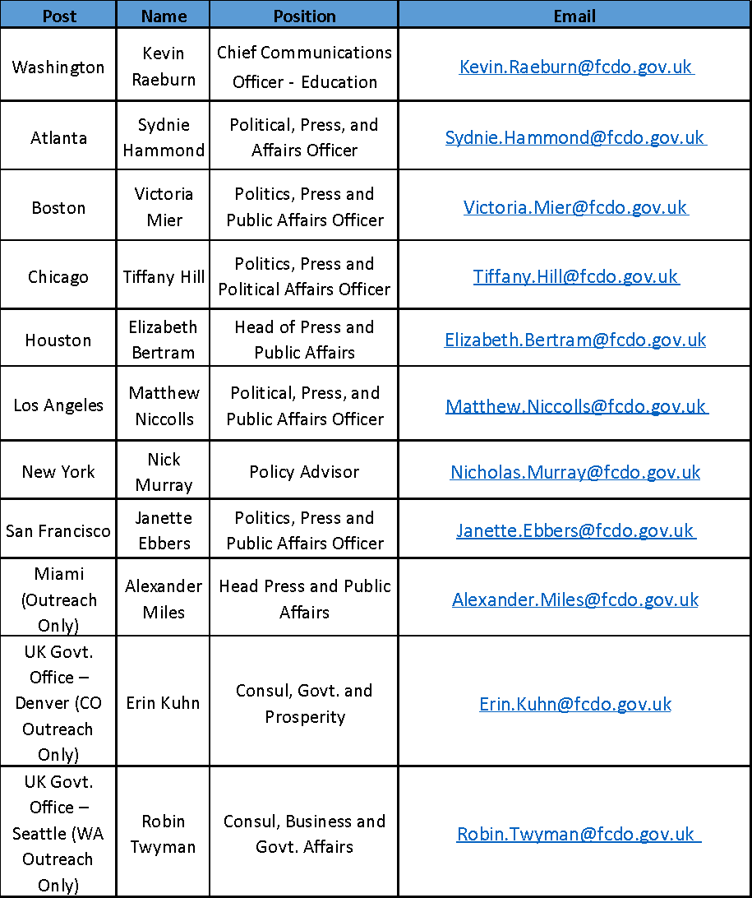
Consular Contacts

